Slide 1



Chicago Crime Analysis
Presented By : Himanshu Kumar Jha
Chicago Crime | 2022

Slide 2
1
Problem Statement
Years ago, as criminal activity surged in Chicago, the government responded proactively by initiating a targeted operation, deploying elite police officers. Now, after a twelve-month period since the inception of this initiative, the government endeavors to assess the impact of the strategy. Specifically, it aims to evaluate the extent of the decline in criminal incidents and the tangible benefits derived from the implementation of this proactive approach.
Chicago Crime | 2022

Slide 3

2
Data Over View
Dataset: Records of incidents featuring key attributes such as ID, Date, Type, Location, Arrest, etc.
Metrics: Count of incidents, Arrest rate, Rate of domestic incidents, Location descriptions, and crime categories.
Exploration: Examination of crime types, locations, and temporal trends to uncover insights.
Quality: Process of removing missing values, validating geographical coordinates to ensure data accuracy and reliability.
Chicago Crime | 2022

Slide 4

3
Methodology
Data Cleansing: Utilized Power BI's Query Editor functionality to systematically clean and standardize the dataset, ensuring accuracy and consistency across all records. Column Generation: Employed DAX formulas proficiently to add supplementary columns, enhancing the dataset's richness for thorough analysis. Advanced DAX Calculations: Developed sophisticated DAX measures to uncover insightful patterns and address intricate analytical requirements with precision.
Visual Representation: Leveraged Power BI's diverse visualization features to create engaging visuals, simplifying data interpretation and enabling in-depth analysis.
Chicago Crime | 2022

Slide 5
Analysis of Objective Questions
4
Data Cleaning: Eliminated null values and generated new columns through DAX formulas.
Analysis of Crime Types: Theft emerged as the most prevalent crime in the dataset.
Evaluation of Arrest Rate: The arrest rate was determined to be 12.42%.
Assessment of District Crime Distribution: District 6 recorded the highest number of reported incidents. Categorical Attributes Identification: Identified several categorical columns within the dataset.
Handling Null Values: Null values were removed from the X & Y coordinate and ward columns.
Analysis of Proportion of Domestic Crimes: Domestic crimes constituted 20.02% of the total crimes.
Analysis of Location Descriptions: Locations described as apartments exhibited the highest frequency of crimes. Average Time Taken to Resolve Cases: The average time taken to resolve a case was found to be 9.03 days. Analysis of Patrol Areas: Beat 511 was identified as having a relatively low incidence of crime.
Comparison of Calculated Columns vs. Added Columns: Utilized DAX formulas for calculated columns and Power Query Editor for additional columns.
Utilizing Calculate and Row Iteration: Calculated the number of theft crimes in District 8.
Separation of Longitude and Latitude: Employed the 'Add Column with Example' feature to split longitude and latitude values.
Usage of M Language in Power Query: M-query was employed for data transformation tasks within Power Query Editor.
Chicago Crime | 2022

Slide 6
5
Analysis of Subjective Questions
Monthly crime rates displayed fluctuations, with a notable drop observed in June.
Strategies for crime reduction encompassed policing, community engagement, and addressing root causes.
Tailored interventions are required for high-crime areas such as Apartment Street.
Wards 42, 27, 28, 6, and 24 necessitate security enhancements.
Crime rates varied by month and day, indicating the necessity for proactive measures.
Arrest rates for domestic crimes were alarmingly low, highlighting an area for improvement.
Common terms in crime descriptions provided insights into prevalent crime types.
Resolution times varied based on crime type and location.
Theft ranked as the most prevalent crime type, followed by battery and criminal damage.
Power BI Gateway enables secure data access and real-time analytics.
A many-to-one relationship exists between districts in crime data and district_ids in a new table
Chicago Crime | 2022

Slide 7
6
Key Analysis Points
Domestic Crime Proportions 20.20%
Total Type of Crimes 31
Arrest Rates 12.42%
Chicago Crime | 2022
Total Number of Crimes 89898
Average Days taken to resolve case 9.03
Key observations derived from the data analysis indicate that Patrol Officer 511 handles fewer cases, theft crimes prevail, May experiences a surge in crime incidents, apartments report a significant number of cases, particularly domestic incidents, accompanied by a lower arrest rate.

Slide 8
7
Conclusion
Chicago's government initiated a focused effort to tackle the city's persistent crime problems by deploying high-performing police officers in a decisive operation over the past year.
The evaluation of this initiative involves analyzing various aspects of crime data to assess its impact and pinpoint areas requiring improvement.
Through meticulous examination, intriguing insights into crime trends have been uncovered, including a notable increase in crime rates until May, followed by a significant decline in June, indicating potential fluctuations warranting further investigation.
The findings underscore the importance of adopting a nuanced approach to crime reduction, emphasizing strategic interventions tailored to specific crime types and localities.
Theft emerges as a prevalent concern, necessitating targeted measures to mitigate its occurrence and enhance arrest rates.
Disparities in arrest rates for domestic crimes have been highlighted, signifying challenges in effectively addressing this complex issue.
By leveraging these insights, evidence-based strategies can be formulated to prioritize public safety and drive meaningful progress in reducing crime rates across Chicago
Chicago Crime | 2022

Slide 9
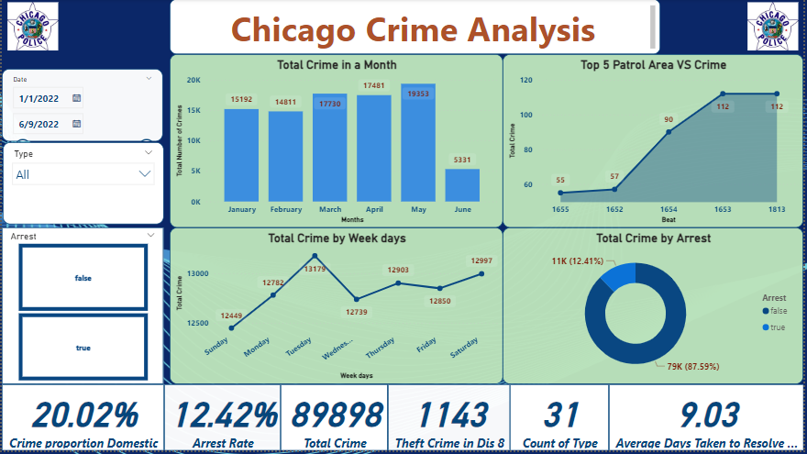
Main Tab
8
Chicago Crime | 2022

Slide 10
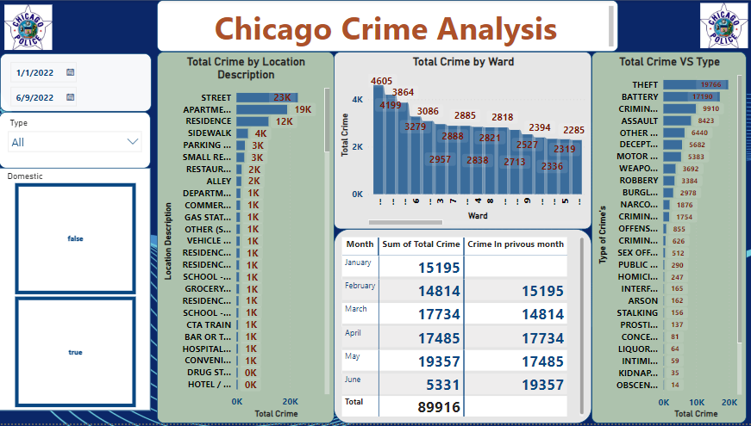
Locality Tab
9
Chicago Crime | 2022

Slide 11
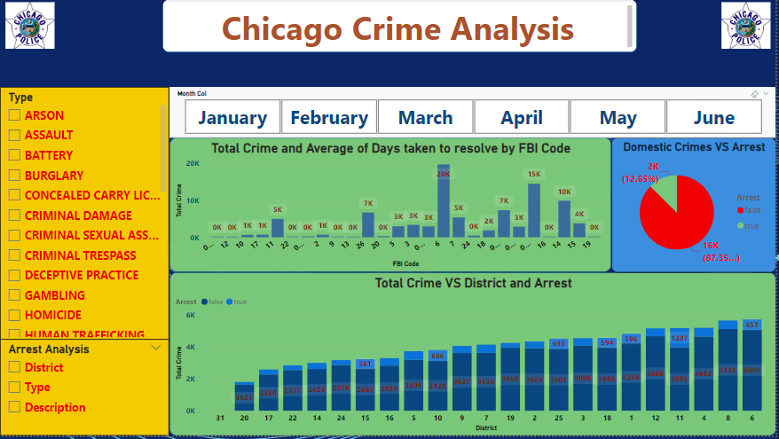
Exploration Tab
10
Chicago Crime | 2022

Slide 12
Chicago Crime | 2022
THANK YOU
Presented By : Himanshu Kumar Jha

